Slide 1


ZenGuard – A Zero Trust, ML-Driven SIEM–SOAR–UEBA Framework
Presented by,
Harish Siddartha – 127158018
Pranav Jai S S - 127003193
Gokulakannan B S - 127003077
Guided By,
Dr Rajakumaran M
Assistant Professor III, School of Computing
1

Slide 2
Abstract
Traditional perimeter-based security is insufficient against insider threats, lateral movement, and advanced persistent attacks, requiring continuous Zero Trust enforcement.
ZenGuard integrates SIEM, UEBA (Isolation Forest), and adaptive SOAR playbooks into a unified, vendor-neutral security automation framework.
Behavioral risk scoring dynamically triggers MFA enforcement, endpoint isolation, IP blocking, and privilege revocation across identity, device, and network layers.
Experimental evaluation demonstrates sub-10-second MTTR for network attacks and reduced false positives compared to static SIEM–SOAR systems.
The framework provides scalable, explainable, and NIST SP 800-207–aligned Zero Trust automation for modern enterprise environments.

Slide 3
Base paper Details
Hassan, A., Rauf, A., Shafqat, N., Latif, R., & Khan, H. (2025). ZenGuard: A machine learning–based Zero Trust framework for context-aware threat mitigation using SIEM, SOAR, and UEBA. Scientific Reports, 15, 35871.
Base Paper Link: https://doi.org/10.1038/s41598-025-20998-4
Indexed in: Scopus and Web of Science (SCI Expanded)
Year of Journal Base Paper Publication: 2025

Slide 4
Literature Survey
Zero Trust Security Model (Palo Alto Networks Whitepaper, 2024)
Description: Industry perspective on Zero Trust implementation strategies and micro-segmentation.
Drawback: Vendor-specific and lacks open, ML-driven automation frameworks.
Inference: Vendor-neutral, API-first Zero Trust architectures address interoperability limitations.
Source link: https://www.paloaltonetworks.com/zero-trust

Slide 5
Literature Survey
Machine Learning in SIEM: A Survey on Intelligent Event Correlation and Anomaly Detection (2025, ResearchGate Preprint)
Description: Reviews ML techniques applied in SIEM systems for event correlation, anomaly detection, and alert prioritization in SOC environments.
Drawback: Primarily focuses on detection enhancement without integrating Zero Trust enforcement or adaptive SOAR automation.
Inference: A gap exists in converting ML-based SIEM insights into real-time, risk-aware enforcement mechanisms.
Source-link: https://www.researchgate.net/publication/398679746_MACHINE_LEARNING_IN_SIEM_A_SURVEY_ON_INTELLIGENT_EVENT_CORRELATION_AND_ANOMALY_DETECTION

Slide 6
Literature Survey
Zero Trust Architecture: A Comprehensive Survey (2021, arXiv)
Description: Provides a detailed survey of Zero Trust models, architectural components, and deployment strategies across enterprise environments.
Drawback: Emphasizes architectural theory but lacks operational ML-based behavioral scoring integration.
Inference: There is scope for integrating Zero Trust with explainable UEBA and automated SOAR playbooks.
Source link: https://arxiv.org/abs/2105.02334

Slide 7
Literature Survey
Reducing the Risk of Social Engineering Attacks Using SOAR Measures (2024, Computers & Security, Elsevier)
Description: Evaluates SOAR-driven automation for mitigating social engineering and phishing attacks in enterprise SOC setups.
Drawback: Uses largely static playbooks without context-aware behavioral risk scoring.
Inference: Adaptive, ML-informed playbooks can improve contextual response precision.
Source link: https://www.sciencedirect.com/science/article/pii/S0167404824004425

Slide 8
Literature Survey
Adoption of SOC Services to Global IT Service Portfolio (2024, Theseus Repository)
Description: Discusses operational integration of SOC services and automation strategies within enterprise IT ecosystems.
Drawback: Focuses on service integration rather than behavioral anomaly detection mechanisms.
Inference: Combining SOC operational models with ML-driven UEBA enhances real-time Zero Trust compliance.
Source link: https://www.theseus.fi/handle/10024/868840

Slide 9
Literature Survey
Developing a Comprehensive Framework for UEBA (2024, Journal of Communication Engineering & Systems – JoCES)
Description: Proposes a structured UEBA framework integrating contextual machine learning for anomaly detection.
Drawback: Limited discussion on SIEM–SOAR orchestration and real-time enforcement workflows.
Inference: A unified architecture combining UEBA, SIEM, and automated response bridges this gap.
Source link: https://journals.stmjournals.com/joces/

Slide 10
Literature Survey
UEBA for SIEM Systems: Preprocessing of CERT Dataset (2023, Journal of Smart Computing and Artificial Intelligence)
Description: Studies preprocessing and feature engineering techniques for UEBA integration with SIEM.
Drawback: Focuses on data preparation rather than adaptive SOAR enforcement.
Inference: Real-time anomaly scoring must be coupled with automated remediation for effective Zero Trust.
Source link: https://dergipark.org.tr/en/pub/jscai/article/1213782

Slide 11
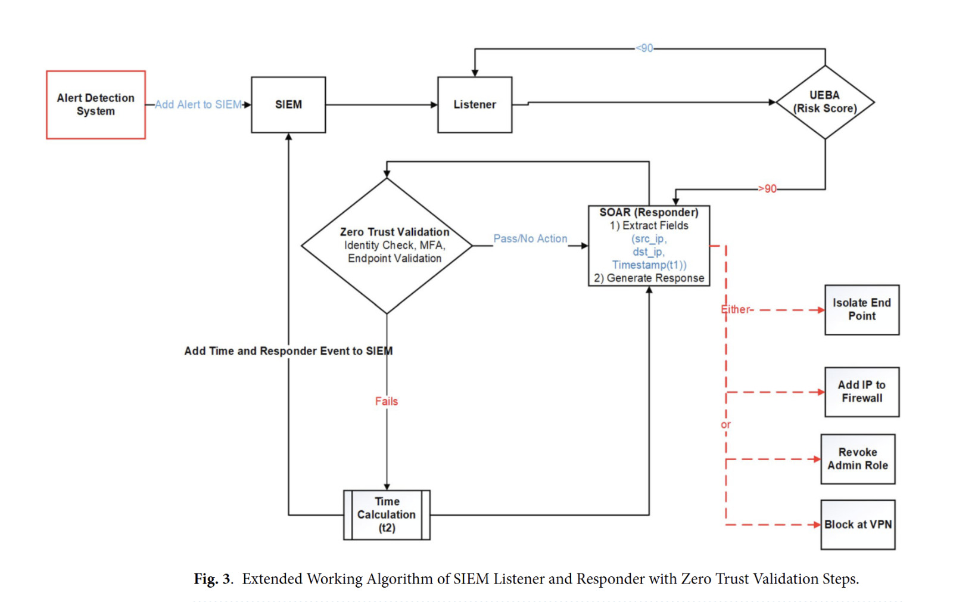
Work Flow Diagram

Slide 12
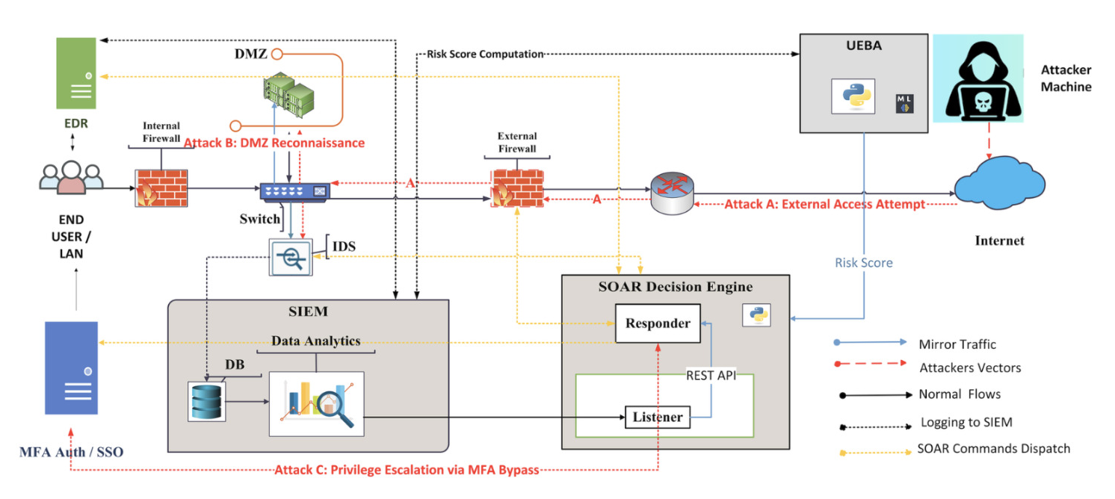
Architecture Diagram

Slide 13
Modules
Module 1: Log Aggregation & Feature Preparation
Collect and normalize logs from SIEM sources (firewalls, IDS, EDR, IdP).
Extract behavioral features such as session duration, failed logins, and privilege changes for UEBA processing.
Module 2: Anomaly Detection & Zero Trust Risk Scoring
Apply Isolation Forest for behavioural anomaly detection.
Convert anomaly scores into discrete risk levels to trigger identity validation, MFA enforcement, and device compliance checks.
Module 3: Automated Response & Enforcement (SOAR)
Execute adaptive Python-based playbooks for IP blocking, endpoint isolation, and privilege revocation.
Log actions in SIEM and display structured risk insights via the dashboard.

Slide 14
Dataset Description
Synthetic Behavioural Dataset
Custom-generated enterprise session logs for UEBA training and validation.
Features include session duration, failed logins, privilege change attempts, MFA bypass, device trust score, and external connections.
80% training / 20% validation split with 15% injected anomaly scenarios.
Public Benchmark Dataset:
CERT Insider Threat Dataset (v6.2) – Insider misuse behavior modeling.
LANL Authentication Dataset – User login and authentication analysis.
UNSW-NB15 Dataset – Network intrusion and attack traffic patterns.
CICIDS2017 Dataset – DDoS and multi-vector cyberattack scenarios.
Enterprise SIEM Log Dataset:
Anonymized QRadar logs simulating real-world SOC operations.
Integrated sources: firewalls, IDS, EDR, VPN, and Identity Providers.
Used to validate scalability up to 1M+ events per hour.

Slide 15
Conclusion
A unified Zero Trust framework was developed, integrating SIEM, Isolation Forest–based UEBA, and adaptive SOAR playbooks to enable context-aware, automated threat mitigation.
Behavioural anomaly scores were transformed into actionable risk levels, triggering real-time identity validation, MFA enforcement, micro-segmentation, and endpoint isolation across user, device, and network layers.
The system achieved sub-10-second MTTR for network-based attacks while reducing false positives compared to traditional static SIEM–SOAR pipelines.
Future enhancements include distributed scalability, adaptive threshold tuning, self-learning playbooks, and expanded hybrid cloud Zero Trust enforcement.

Slide 16
References
Rose, S., Borchert, O., Mitchell, S., & Connelly, S. (2020). Zero Trust Architecture. NIST Special Publication 800-207. doi:10.6028/NIST.SP.800-207.
Syed, N. F., Shah, S. W., Shaghaghi, A., Anwar, A., Baig, Z., & Doss, R. (2022). Zero trust architecture (ZTA): A comprehensive survey. IEEE Access, 10, 57143–57179. doi:10.1109/ACCESS.2022.3159699.
Marri, H., Patel, K., & Agarwal, P. (2024). Machine learning in SIEM systems: Enhancing threat detection capabilities. IEEE Transactions on Information Forensics and Security, 19, 250–270. doi:10.1109/TIFS.2023.3312345.
Hariri, S., Moustafa, N., & Sitnikova, E. (2021). Adversarial machine learning in network intrusion detection: Current status and future challenges. Neural Computing and Applications, 33, 10231–10261. doi:10.1007/s00521-021-05920-0.

Slide 17
References
Schlette, D., Empl, P., Caselli, M., Schreck, T., & Pernul, G. (2024). Do you play it by the books? A study on incident response playbooks and influencing factors. IEEE Symposium on Security and Privacy, 3625–3643. doi:10.1109/SP54263.2024.00074.
Lin, P.-C., Chiu, Y.-H., & Chen, C.-H. (2019). Endpoint detection and response: A survey and open research issues. IEEE Access, 7, 170351–170365. doi:10.1109/ACCESS.2019.2953418.
Guha, S., Mishra, N., Roy, G., & Schrijvers, O. (2016). Robust Random Cut Forest based anomaly detection on streams. Proceedings of the 33rd International Conference on Machine Learning (ICML), 2712–2721.

Slide 18
THANK YOU

